Slide 1
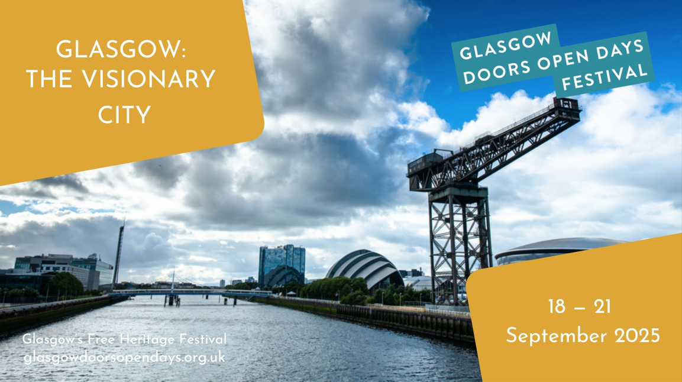

Slide 2
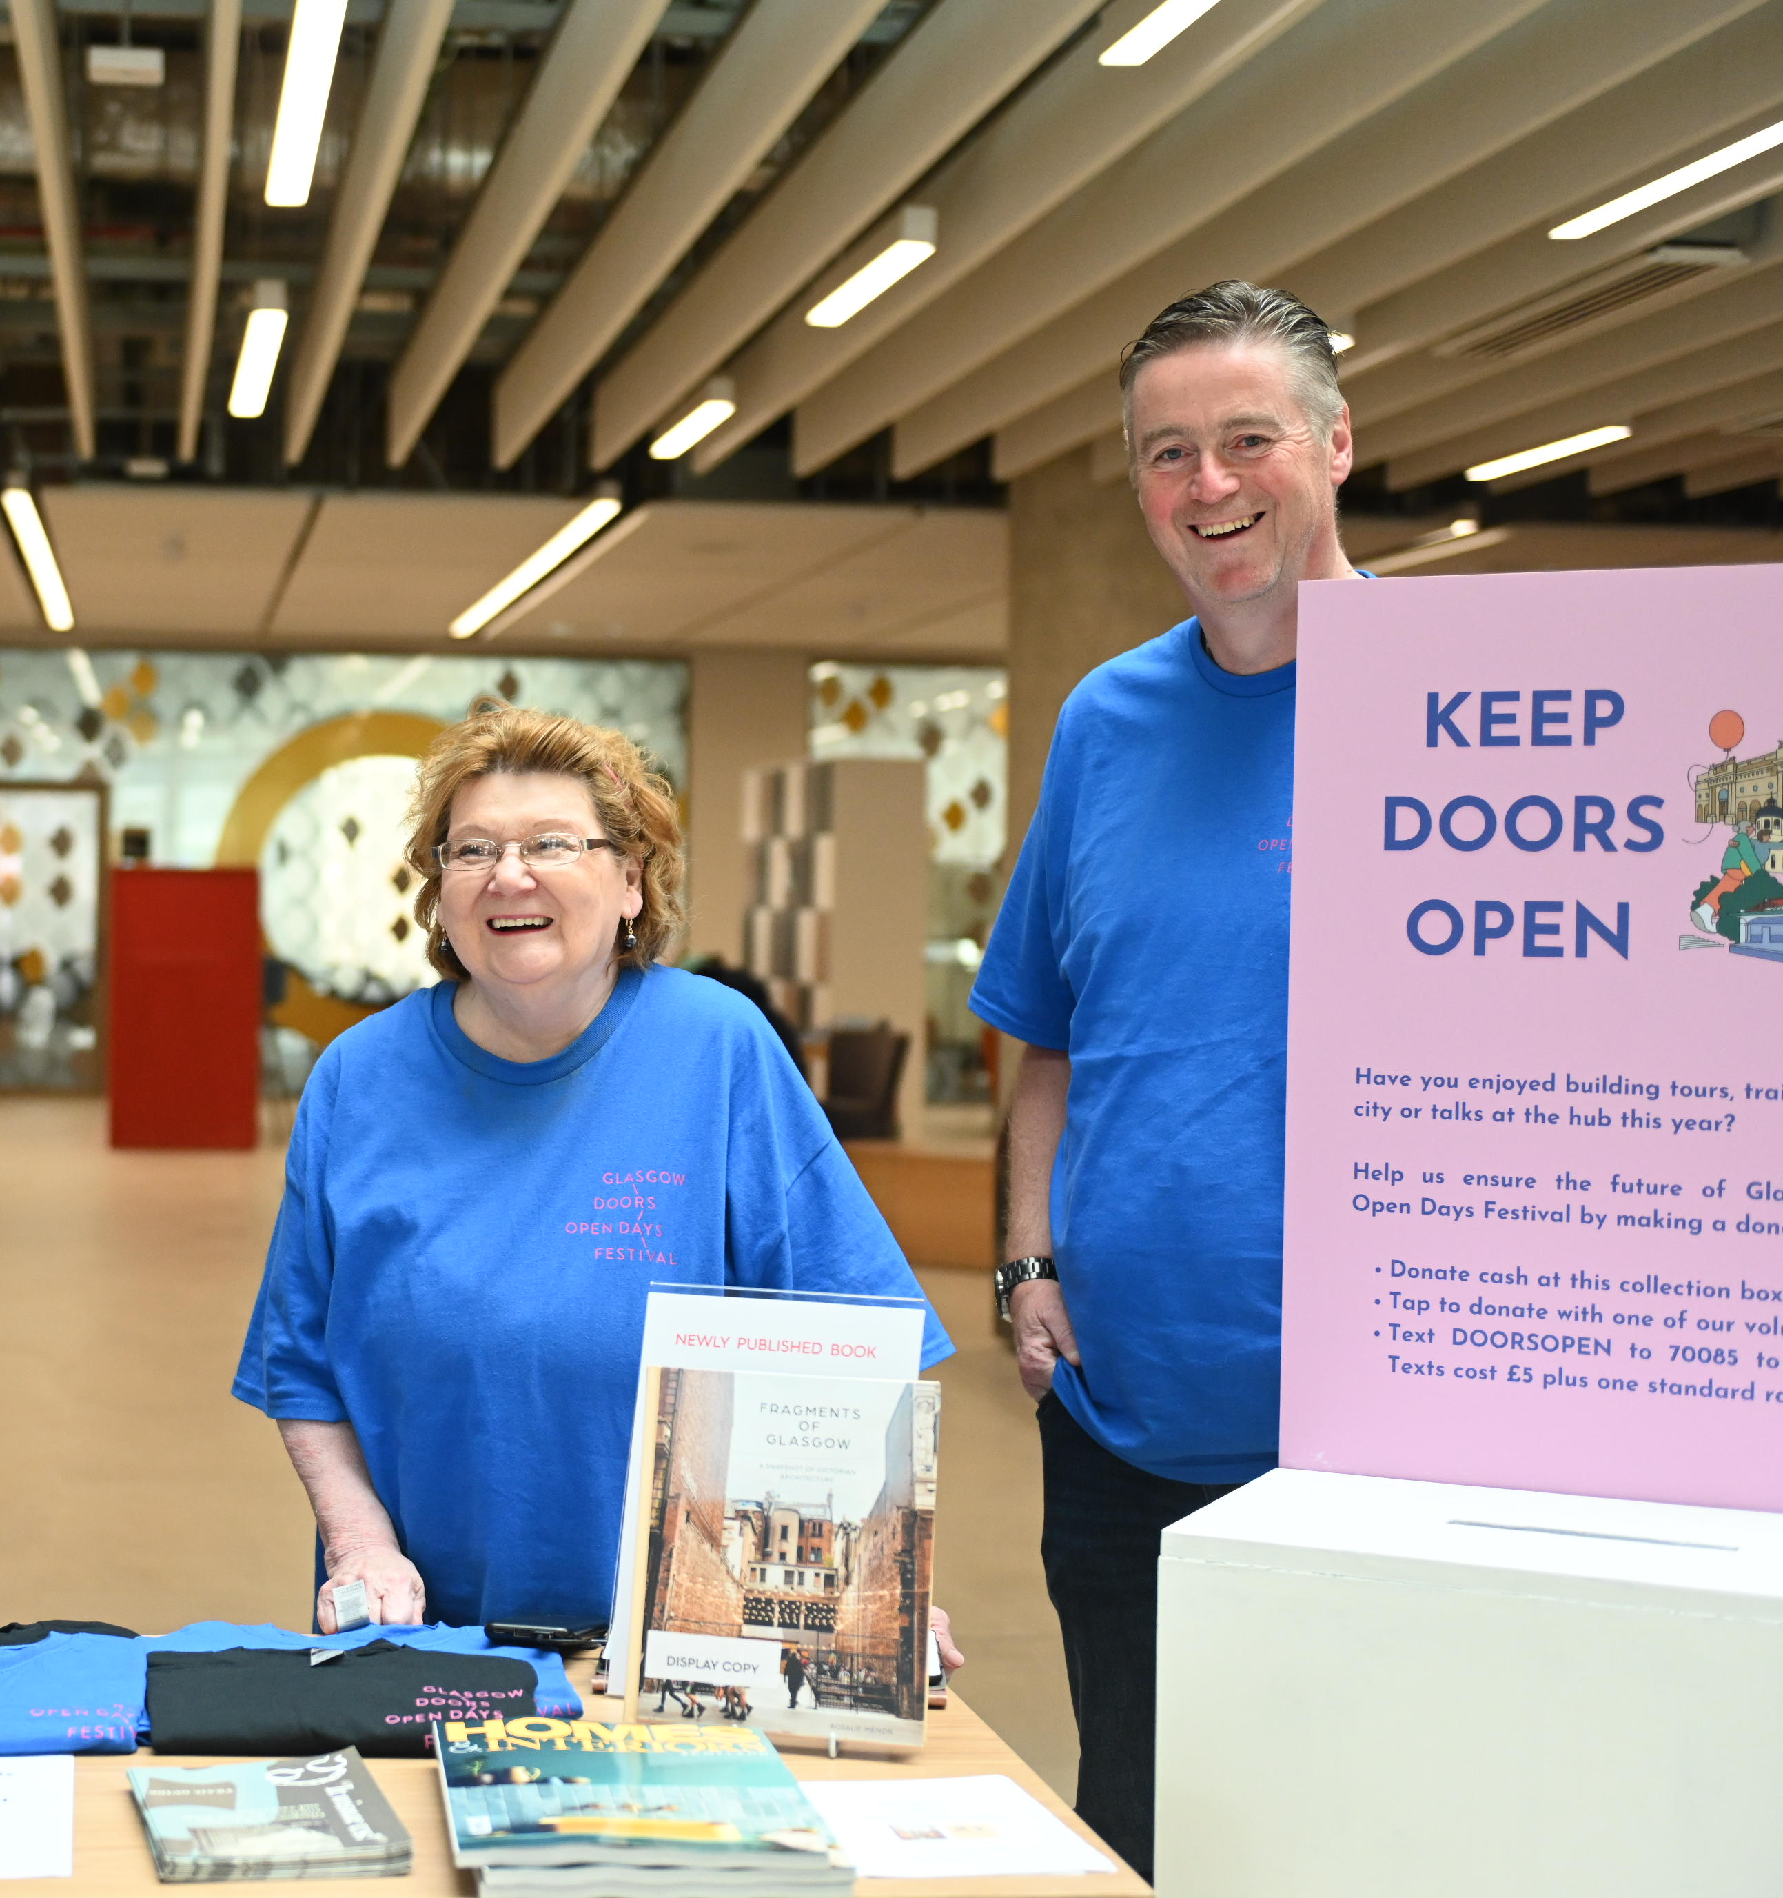
AGENDA
Welcome and Thanks
Introductions to the Festival Team
What is Doors Open Days?
Participating
Website and Support
Key Dates
Participant Insurances Checklist
Your online listing
Theme – “Glasgow: the visionary city’
Marketing Resources and Information Sharing
Glasgow Building Preservation Trust
Civic Reception
Q&A

Slide 3
2024 Festival Highlights
Notes:
2024 Highlights: More than 100 buildings, 60 events and 30 trails came together to make Glasgow Doors Open Days Festival 2024 happen.

Slide 4
Festival Team
We have a new Festival Team this year:
Yvonne Caddell - Festival Manager
Joe Robins - Marketing & Audience Development Officer
Jamie Whyteside– Festival Assistant
Emma West– Youth Engagement Intern (Glasgow Uni Find A Solution Internship)
(Some of the team are part-time, but there will always be someone working in the run up to and we will all be full-time during the Festival)

Slide 5
Contacting the Festival Team
Please contact us on doorsopendays@gbpt.org
All team members have access to this mailbox
Main Phoneline T: 0141 554 4411

Slide 6
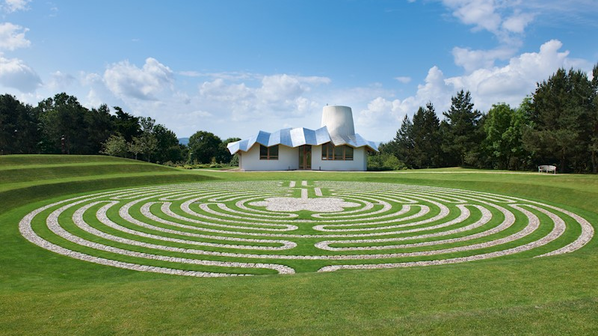
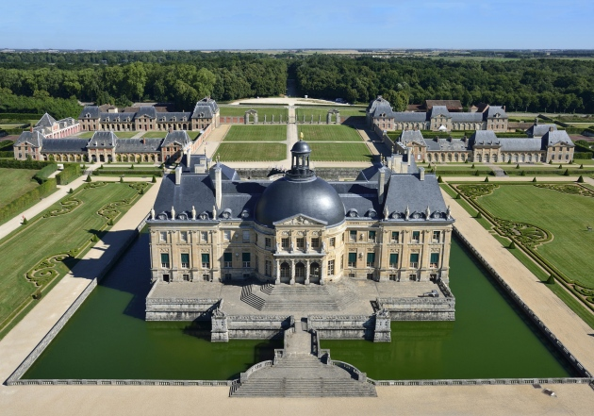
What is Doors Open Days?
Organised by the Scottish Civic Trust, Doors Open Days is Scotland’s largest free festival that celebrates heritage and the built environment. It offers free access to over a thousand venues across the country throughout September, every year.
European heritage days
Doors Open Days forms part of Scotland’s contribution to European Heritage Days which take place across Europe.

Slide 7
GlaSGOW DOORS OPEN DAYS FESTIVAL 18–21 September
Glasgow Doors Open Days Festival is the largest free heritage and cultural festival in Scotland and a much-loved celebration of the city’s architectural gems, history, and local communities attracting over 30,000 visits per year.
Over 100 buildings and sites across the city annually open their doors to visitors each September, offering a wide range of free activities, including walks, talks, tours, children’s activities, and more.
It is a community-driven festival and opportunity for venues across the city to showcase their activities and assets, connect with local audiences and visitors, support the festival’s mission to inspire civic pride, and highlight Glasgow as a culturally vibrant and sustainable city.
The festival has been organised by Glasgow Building Preservation Trust since it began in 1990 as part of the City of Culture celebrations.
Visit glasgowdoorsopendays.org.uk to find out more

Slide 8
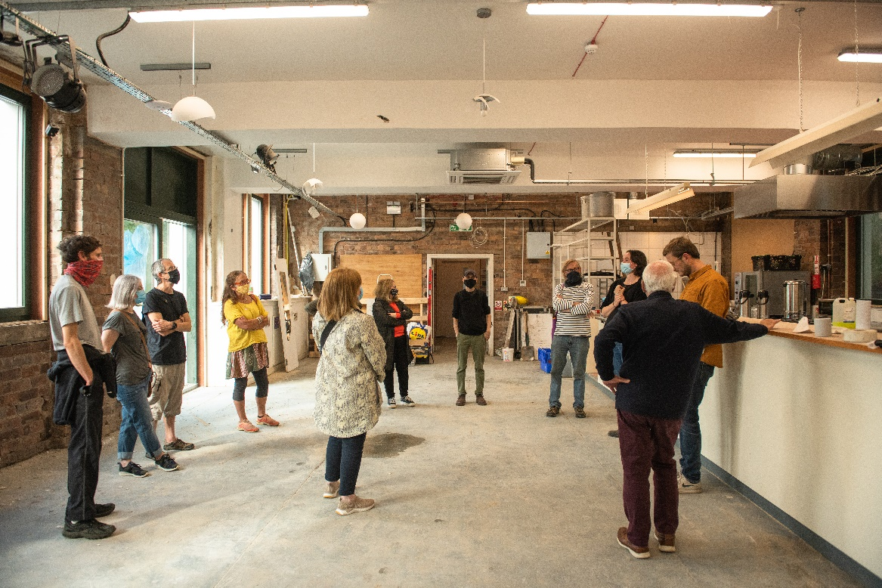
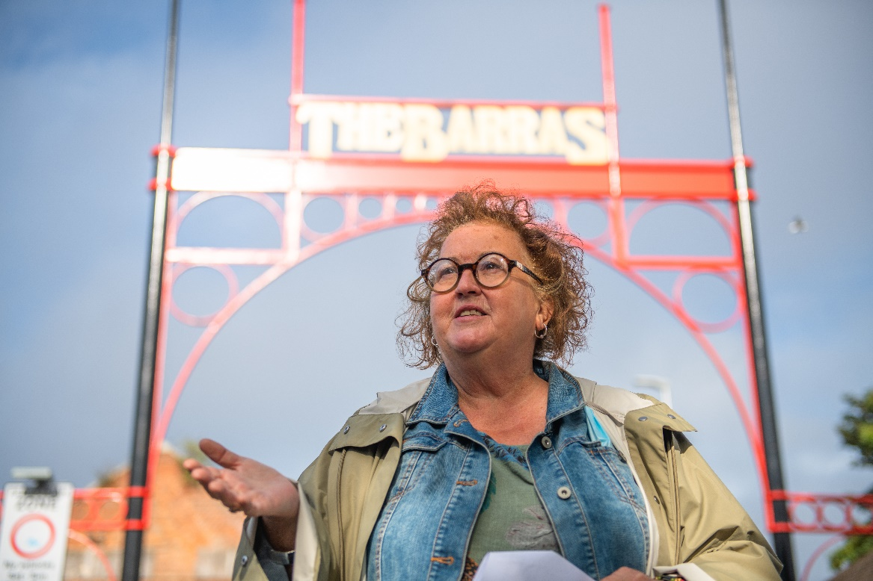
What is participating?
Opening a building
Leading a walking trail
Hosting a event
Don’t forget digital!
The majority of participants are motivated to take part to reach out to the local community (20%) to raise their profile (21%) and because they enjoy it (21%).

Slide 10
Sheriff Court
Notes:
Guided walks are now a staple of Glasgow’s programme. We are very lucky to have so many people who are keen to share their knowledge of the city

Slide 11
GSA Archives
Notes:
It’s always an exciting adventure, finding out new information about the streets you walk year in year out, in your daily life.

Slide 12
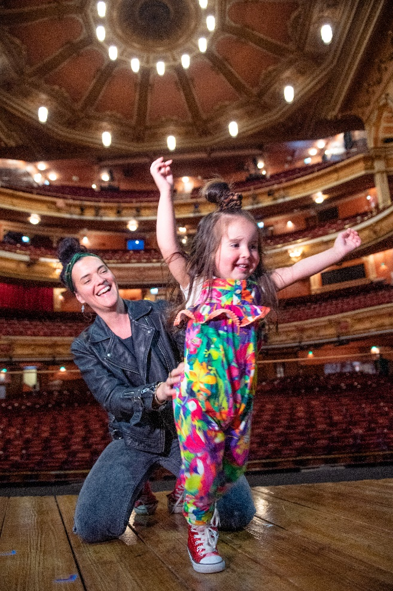
What are we looking for?
Relating to the Glasgow Doors Open Days aims and mission
Free to attend
Something extra during doors open days
Notes:
In short what we are looking for are events relating to the Glasgow Doors Open Days aims and mission and theme, events are free to attend, and if buildings are usually open to the public, that they do something extra during doors open days.

Slide 13
FESTIVAL AIMS
To increase the number of Glaswegians and visitors who are engaged in celebrating and learning about Glasgow’s rich built heritage, architecture and culture.
To increase the profile of Glasgow as a destination for domestic and international tourists who are interested in history, heritage and built environment.
To provide public education and opportunities to stimulate discussion of current issues in design, planning and preservation of heritage buildings
Notes:
These aims include:
To increase the number of Glaswegians who are engaged in celebrating and learning about Glasgow’s rich built heritage, architecture and culture.
To increase the profile of Glasgow as a destination for domestic and international tourists who are interested in history, heritage and built environment.
On that I will say that last year we recorded 10% of our festival audience was from outside Scotland and 5% from outside the UK.
We had folks tuning in from all over the world, as far as Australia and New Zealand, taking part in talks – and that’s really exciting that the work you are doing, really is finding an international audience and we’ll be looking to make the most of this possibility this year.
To provide public education and opportunities to stimulate discussion of current issues in design, planning and preservation of heritage buildings

Slide 14
FESTIVAL MISSION
Celebrating the city’s architecture, culture and heritage through a free programme of open buildings and events.
To increase civic pride among Glaswegians and to broaden awareness of the city's rich built & cultural heritage at local, national & international levels.

Slide 15
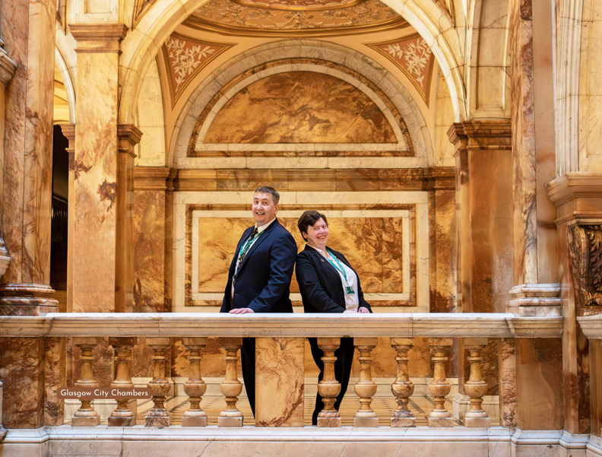

Slide 16
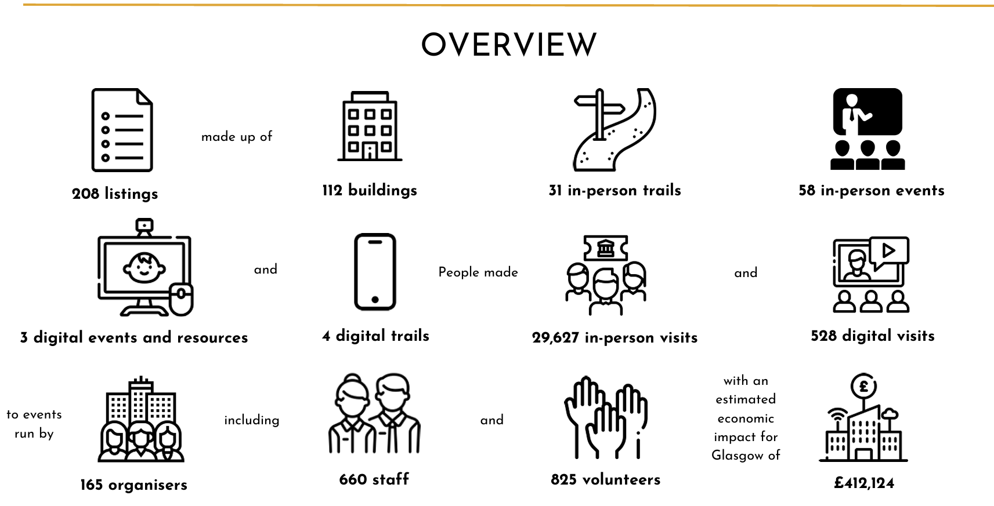

Slide 17
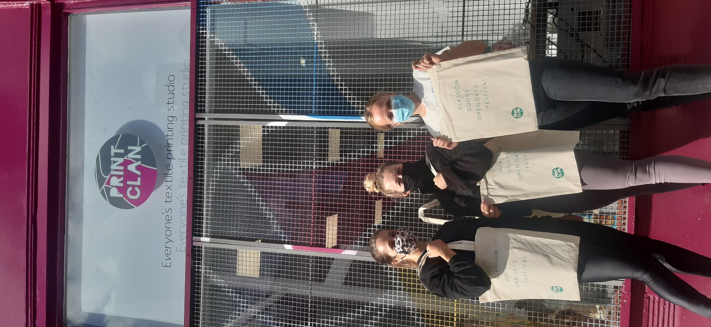
How to make your event fit the festival programme?
Theme
Accessibility
Children and Young People
Equality, Diversity & Inclusion
Educational Value
Relevance

Slide 18
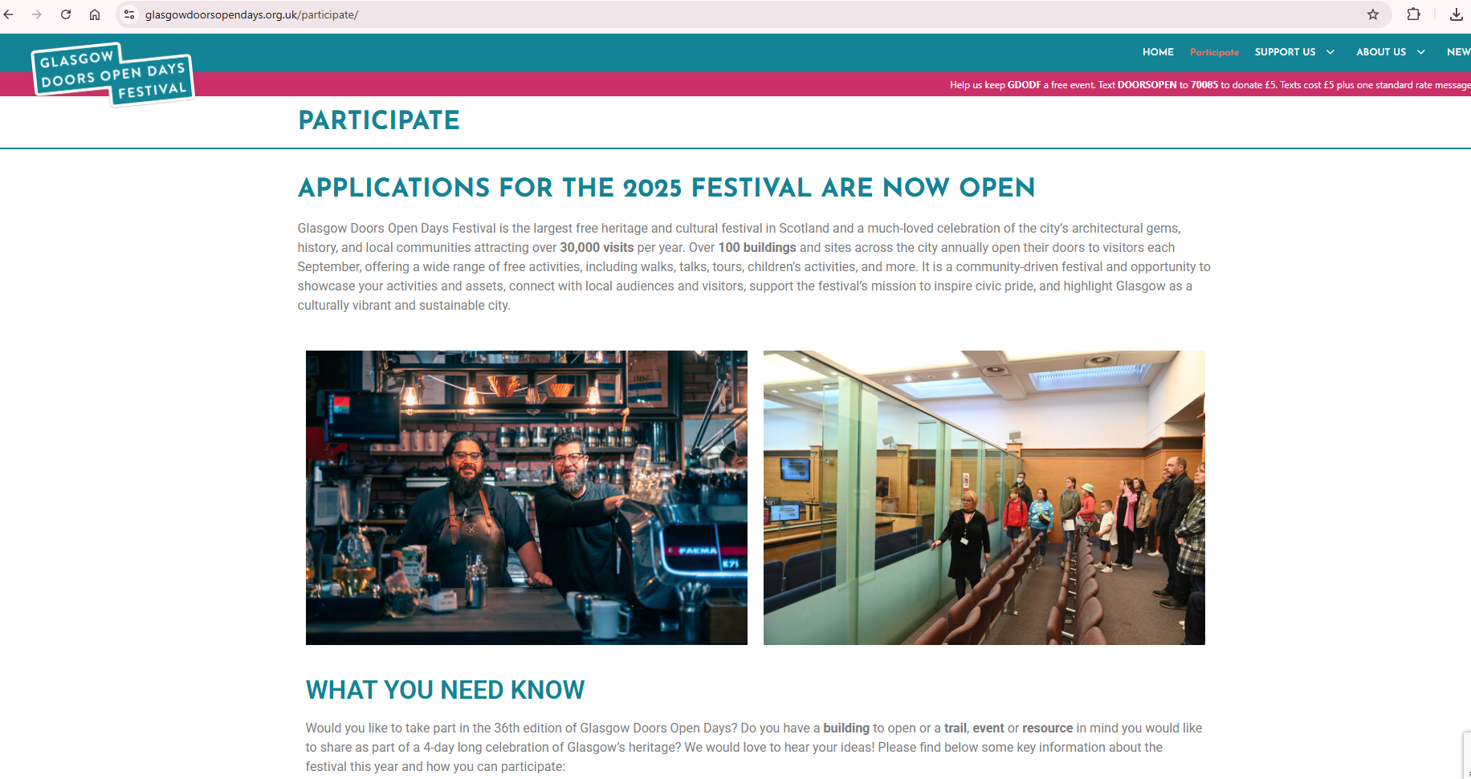
Notes:
https://glasgowdoorsopendays.org.uk/participate/

Slide 19
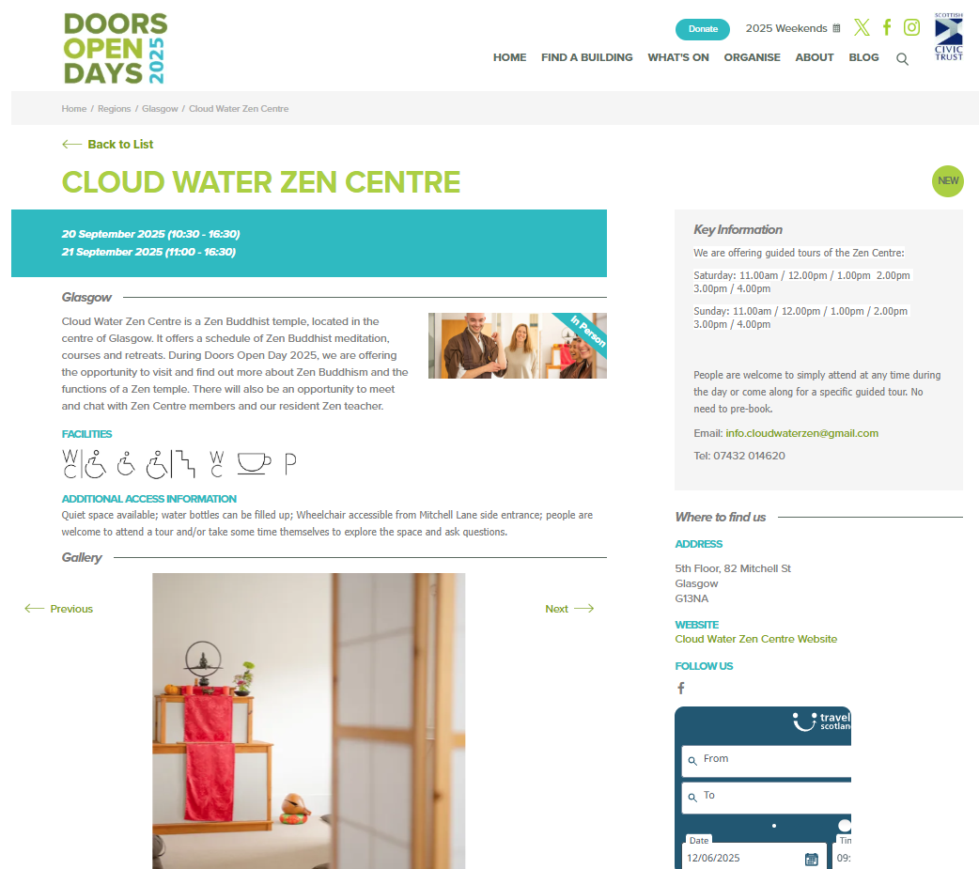
Example of 2025 Online Listing

Slide 20
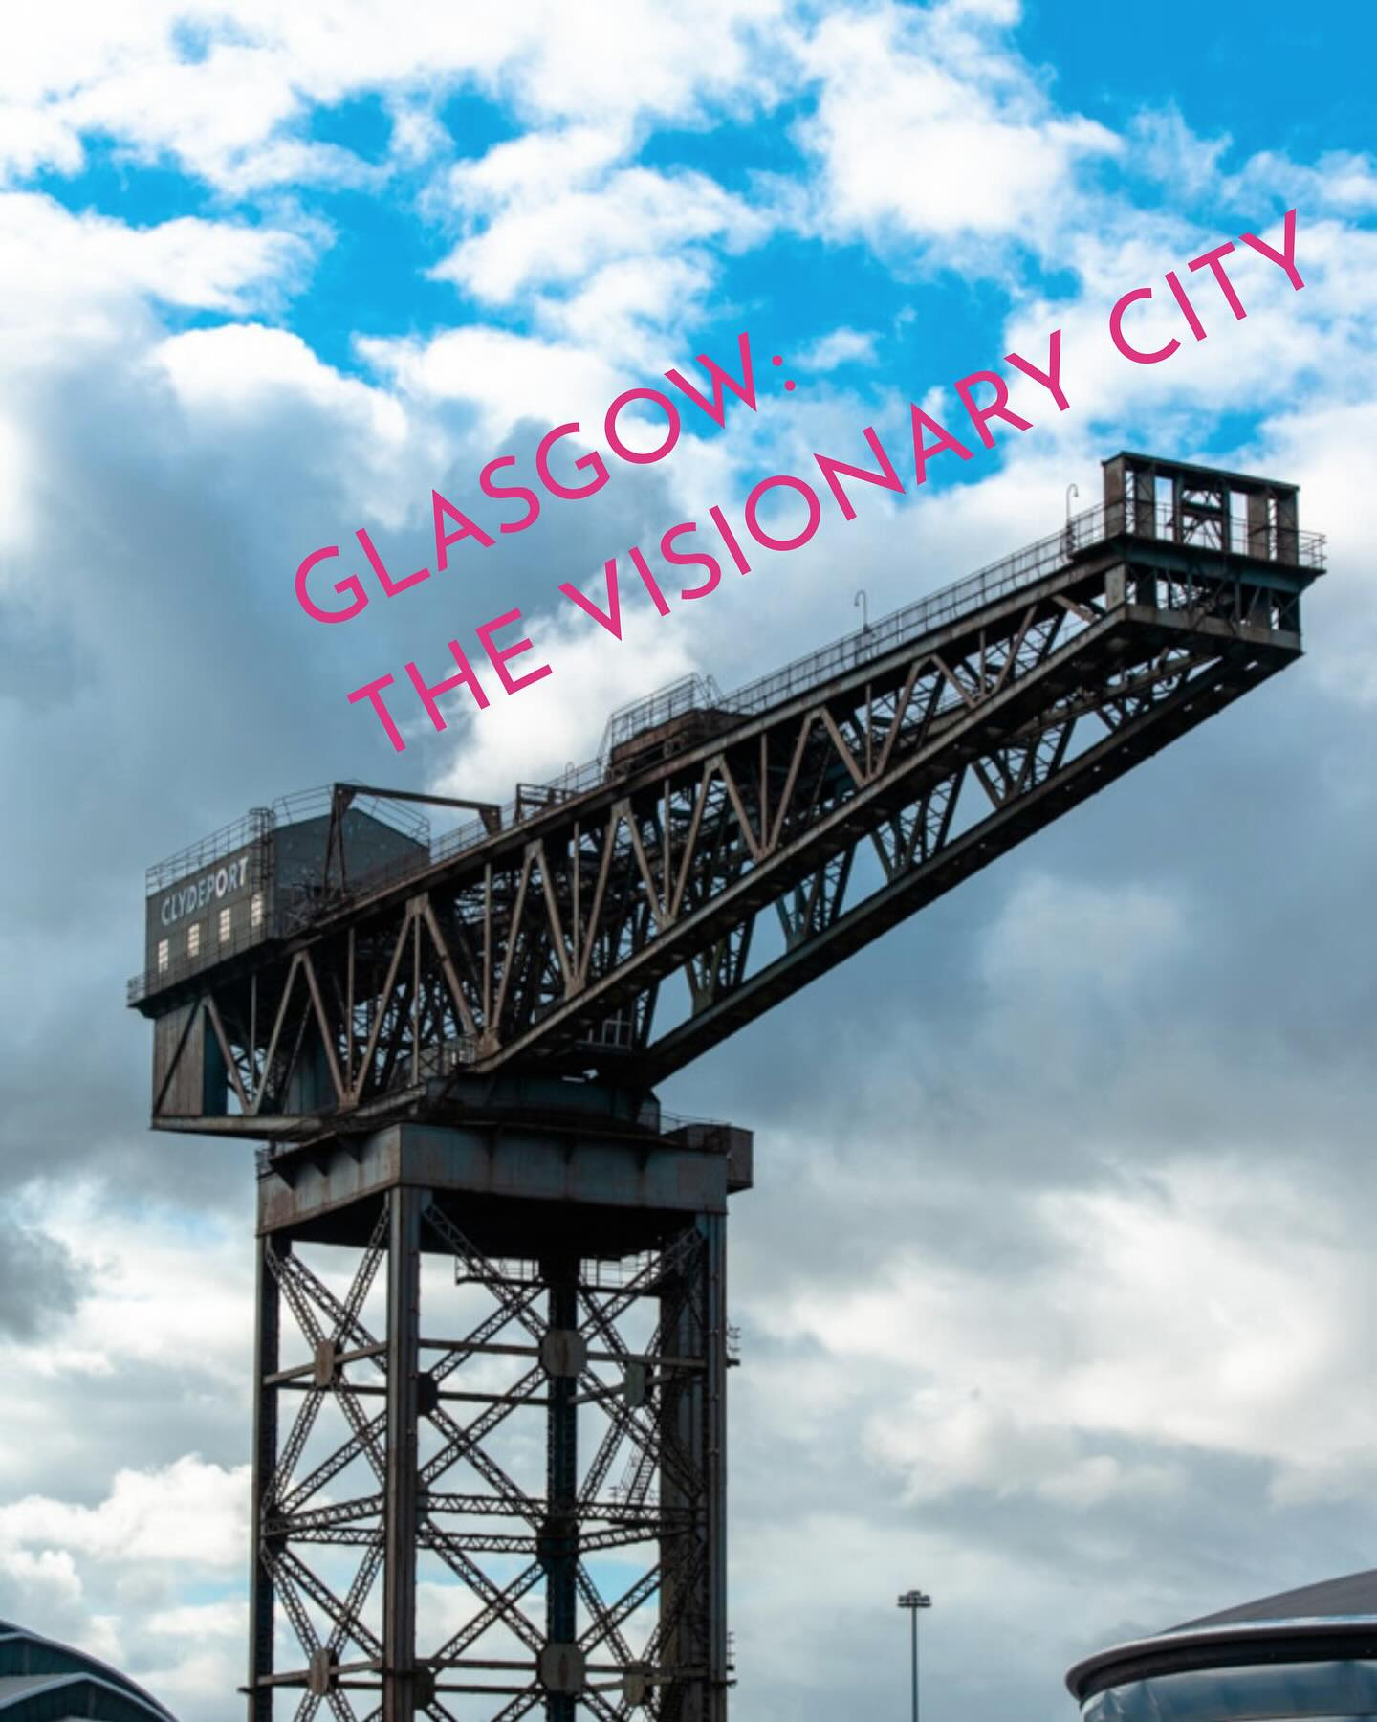
Festival Theme:
Glasgow: the visionary city
We’d love our participating venues to embrace our festival theme of Glasgow: the visionary city in their own distinctive and meaningful way.
Are you working on plans or projects that will renew, rescue and/or redefine what your organisation, building, venue, space or site will look like in the future?
Are you in the process of reclaiming or rescuing areas that have been disused or derelict for years? What difference will this make to your local community?
Are you working with any local community groups, artists, third sector or commercial organisations to reimagine future uses for your space, venue, site or building? If so, can you share work-in-progress with festivalgoers?
What might you or your organisation, building, venue, space, garden or site be doing differently in 3 years, 5 years or even 10 years’ time?
Notes:
We’ve come up with some initial prompts which you can use or adapt to help guide your creativity and planning.
• Could you use your socials to share your own and festivalgoers’ ideas and experiences linked to our theme and/or your plans for your future?
• Could you use digital or physical boards, sticky notes or chalkboards to capture festivalgoers’ feedback? How about QR codes or online links to surveys?
We think festivalgoers would be thrilled to hear your future ideas or plans for your historic building, heritage site, community hub or garden, place of worship, organisation, workplace, factory, city space, place of worship, entertainment venue, cinema or private residence, if you are able to share them. We’d also love for you to post photos and videos during Glasgow Doors Open Days Festival 2025 that capture the festivals energy using our #GDODF hashtag

Slide 21
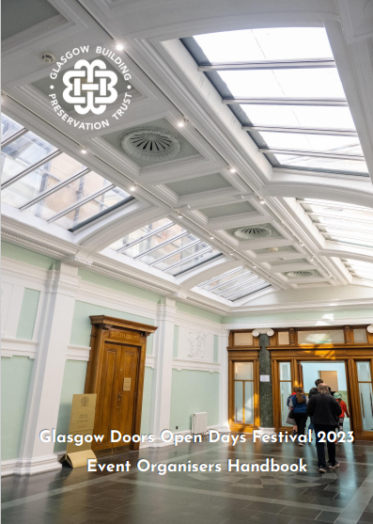
Participant responsibilities
Deliver your event as detailed in your final submission
Make changes up until the submission deadline of 22nd July by contacting us at doorsopendays@gbpt.org
Any changes after this please inform us in the same way, via doorsopendays@gbpt.org
Display and then return promotional material.
Make sure you are insured. Scottish Civic Trust offers advice on insurances & carrying out a risk assessment in advance of opening your doors to the public as part of the GDODF.
Complete our Participating Venues Checklist 2025 and return this to us by 22nd July at doorsopendays@gbpt.org
We recommend you carry out a risk assessment for the safety of your staff, visitors and property.
Report accurate visitor numbers.

Slide 23
Glasgow Building Preservation Trust
Glasgow Building Preservation Trust is a charity that works to rescue, repair, restore and rehabilitate historic buildings at risk across the city.
We work in partnership with others to give redundant buildings a new purpose and return them to their communities.
Established in 1982 to take on the redundant Briggait Fish Market which at the time had been threatened with demolition.

Slide 24
Bridgegate Fish Market

Slide 25
Notes:
2027 Castlemilk Stables

Slide 26
Notes:
Castlemilk Stables

Slide 27
West Boathouse

Slide 28
West Boathouse

Slide 29
Notes:
West Boathouse

Slide 30
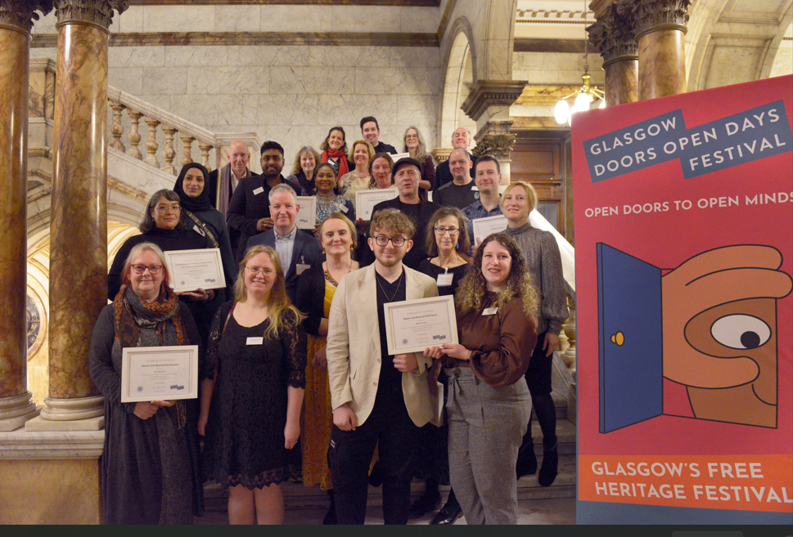
Civic Reception and Awards Tuesday 11th November

Slide 31
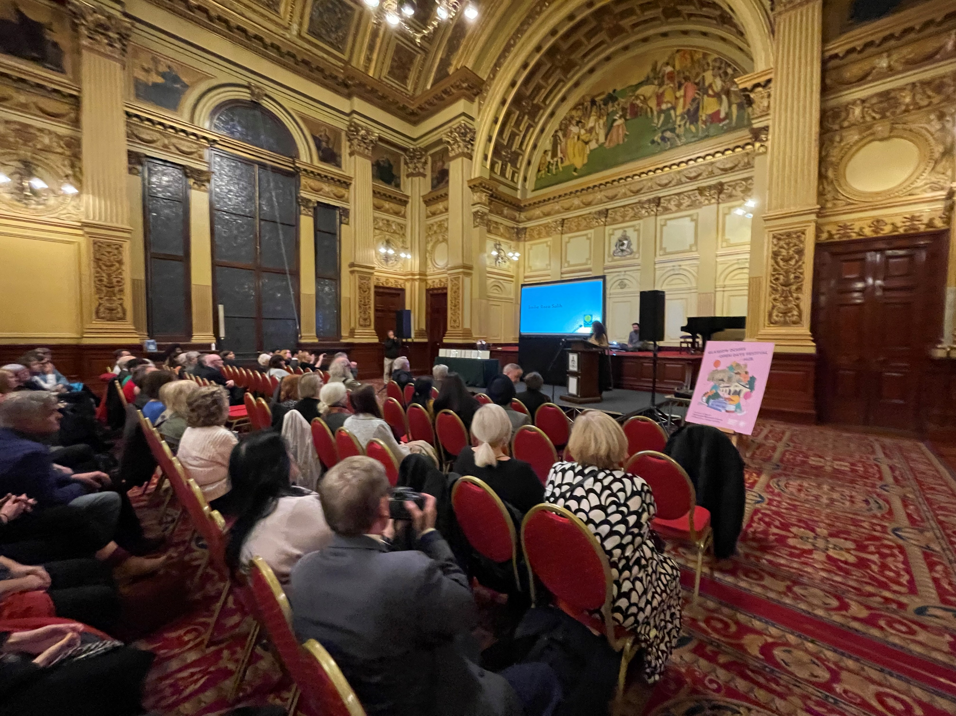
Awards

Slide 33
Questions

Slide 34
Thank you
doorsopendays@gbpt.org
www.glasgowdoorsopendays.org.uk
#glasgowdod2025
#doorsopendays
#visionarycity

